Slide 1
NASA Under Wearables
Xueting Zhang, Anna Russell, Stephen Camp, Richard Bardianu, Parth Patel

Slide 2
Project Overview
A smart garment infrastructure for monitoring astronauts
Plug-and-play design for multiple sensors
Fits underneath the EVA suit
Flexible

Slide 3
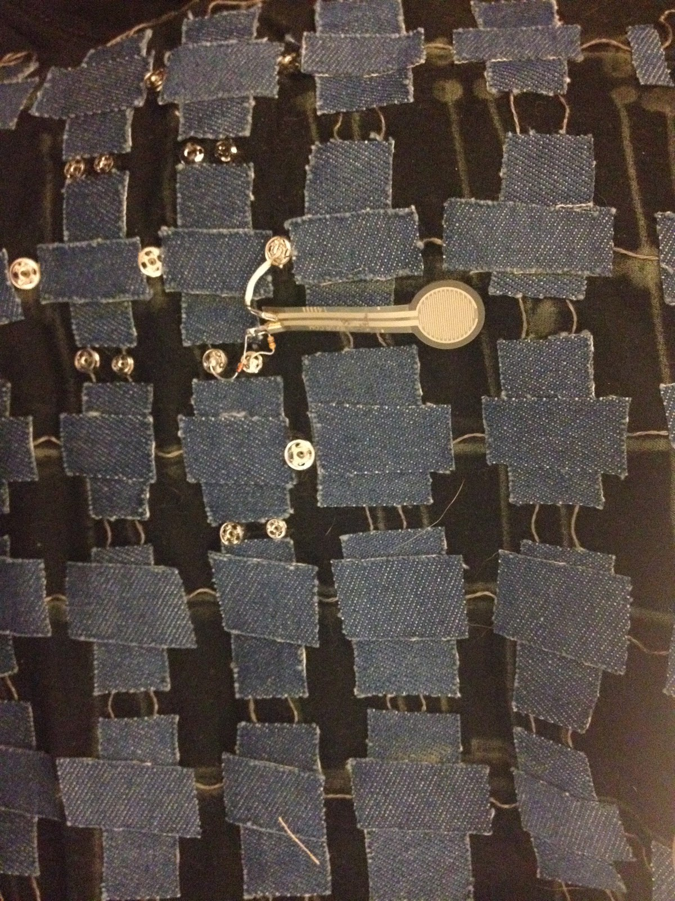
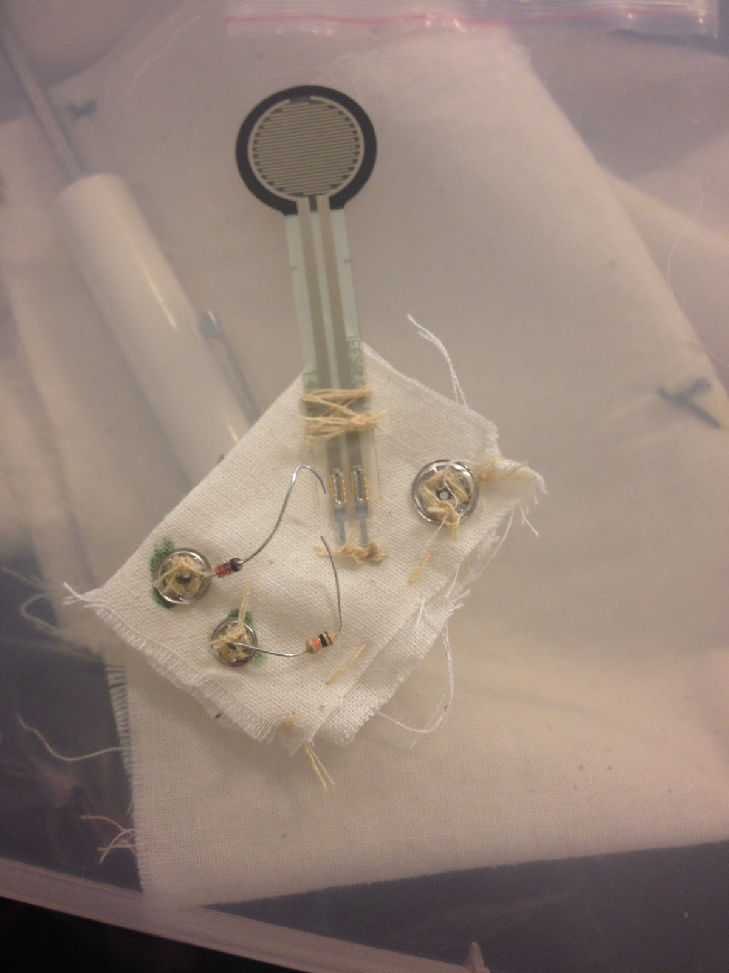
Design

Slide 4
Design (Cont.)
Power leads run horizontally
Data and ground leads run vertically
Patches of fabric keep lines insulated at intersections
Snap buttons act as connection hubs

Slide 5
Testing
Design functionality was tested using Arduino Uno
Three different sensors were attached on a single data lead
Collected simultaneous input from all three sensors

Slide 6
Future Considerations
Automatic sensor identification
Power routing hubs
Supplying constant power through each lead
Minimize signal noise

Slide 7
Conclusion
Plug-and-Play infrastructure
Multiple sensors on one data lead
Flexibility/Comfort
Sensor location

